Slide 1
Python course 3
Function

Slide 2
Use function
range(5)
max([1,2,3]), min([1,2,3])
list(range(4)), str(123), int(5.5)

Slide 3
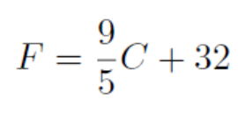

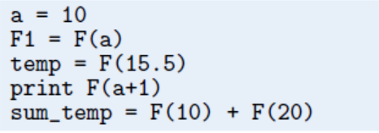
Define a function
Celsius-Fahrenheit Conversion

Slide 4
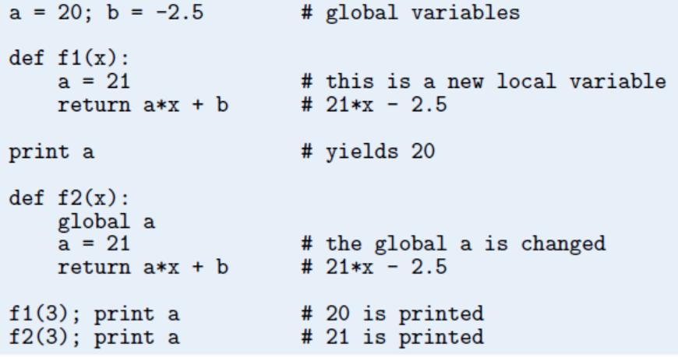
local vs global variables

Slide 5

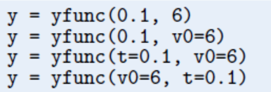
Multiple Arguments

Slide 6
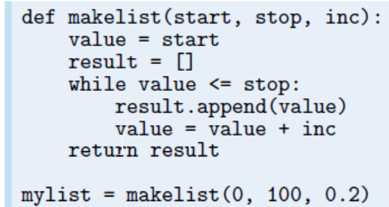

Slide 7
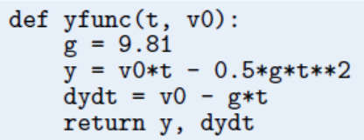
Multiple Return Values

Slide 8

Functions with No Return Values

Slide 9
Keyword Arguments
somefunc(’Hello’, [1,2])
somefunc(’Hello’, [1,2], kwarg1=’Hi’)
somefunc(’Hello’, [1,2], kwarg2=’Hi’)
somefunc(’Hello’, [1,2], kwarg2=’Hi’, kwarg1=6)

Slide 10
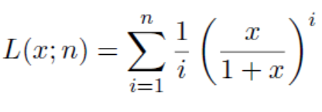

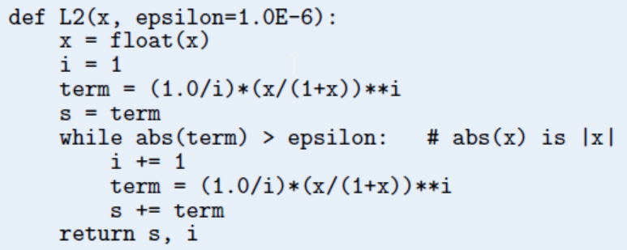


Slide 11
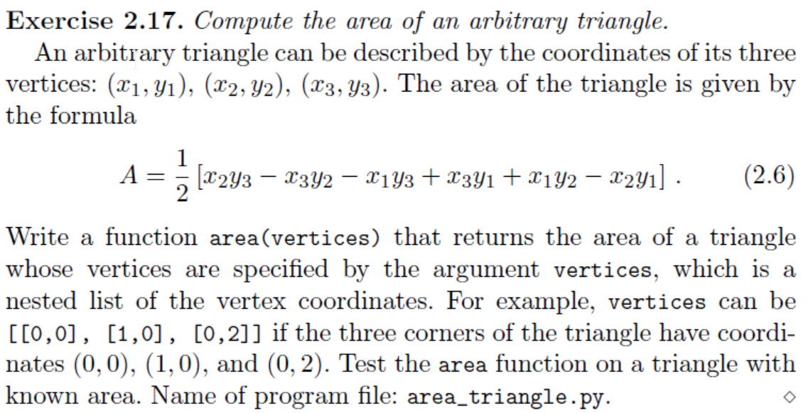

Slide 12

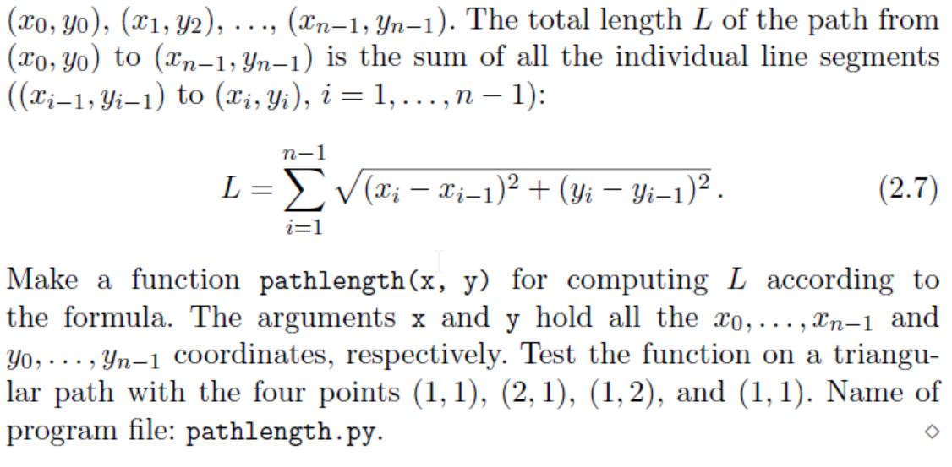

Slide 13

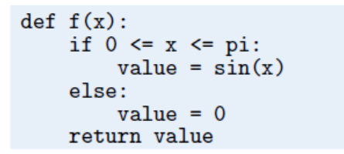

Slide 14
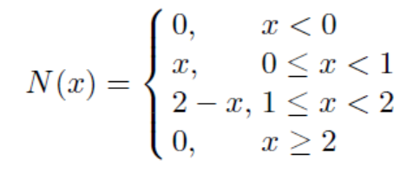
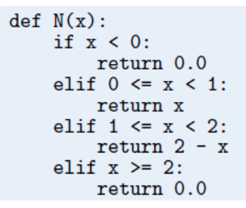

Slide 15
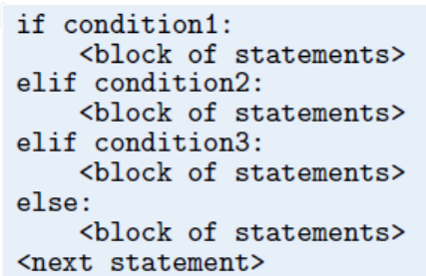

Slide 16
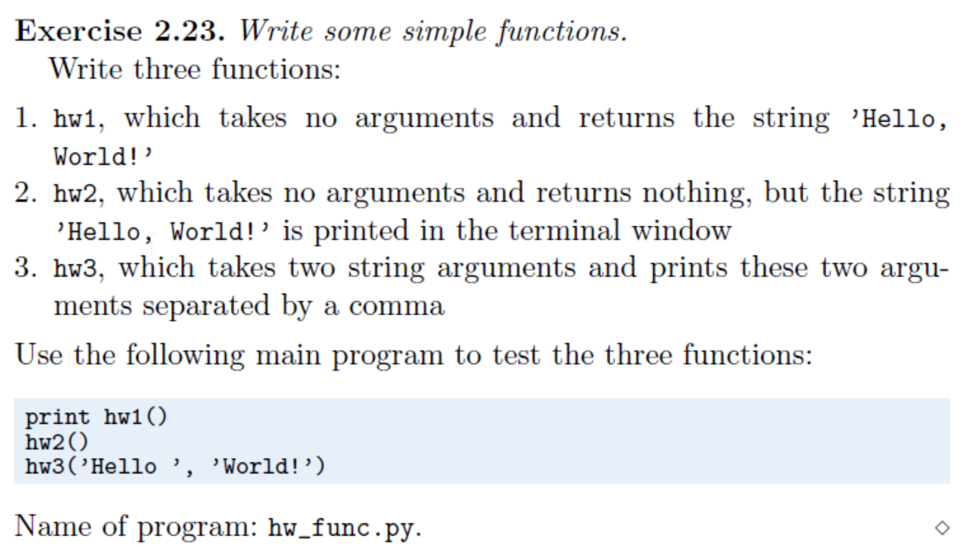

Slide 17



Slide 18



Slide 19
